Slide 1

AI DRIVEN ADJUSTMENT OF PUBLIC IMAGES/VIDEOS FOR COMPLIANCE TO GENERAL DATA PROTECTION REGULATION (GDPR)
November 3, 2022

Slide 2
Group Members
Dharmesh Patel
Jemty Jose
Muhammad Suleman
Muhammad Azhar Mehboob

Slide 3
Table of Content
What We Proposed
What Have We Completed
Data Collection
Data Training/Testing
Build a Working ML Model
2k/20k
High False Negative
App
Show UI
Kivy Library
What Is Left
Check Other Models
Mask RCNN
Code structure
concept for execution of the task Cresults of literature search
Update timeline
Update risk assessment

Slide 4
Background
Purpose of this Project is make sure that we project the privacy of the Individual.
We intend to implement the General Data Protection Regulation (GDPR) by using an AI Model of Public Images.
To avoid any misuse of data.
In this presentation, we will be briefly going through the updates/progress of the AI Model.

Slide 5
CODE STRUCTURE
Collect Images and Label
---Collect and Label images for Object Detection using LabelImg
Training models- Train Deep Learning powered Object Detection Models using Python and TFOD
Detecting Objects Detect objects in real time using a webcam and using Images
Freezing and Conversion Tune Object Detection models to improve Precision and Recall
Performance Tuning

Slide 6
2k/20k

Slide 7
Application
App interface: For the application front end and back end, we are using Kivy, kivyMD and other useful extension.
Kivy:
Based on Python.
Easy to use widgets built with multi-touch support.

Slide 8
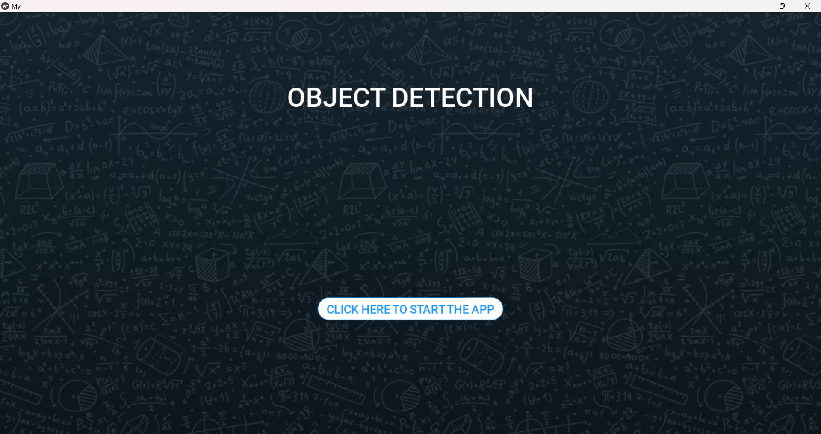
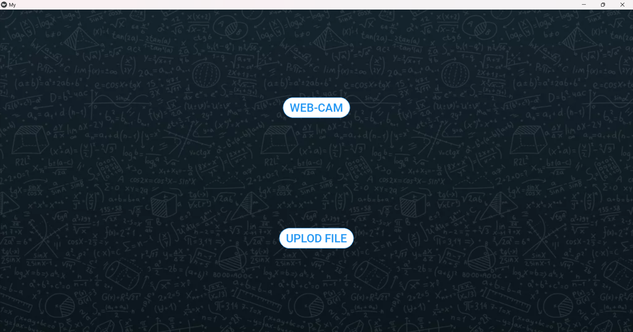
Application: Front-End

Slide 9
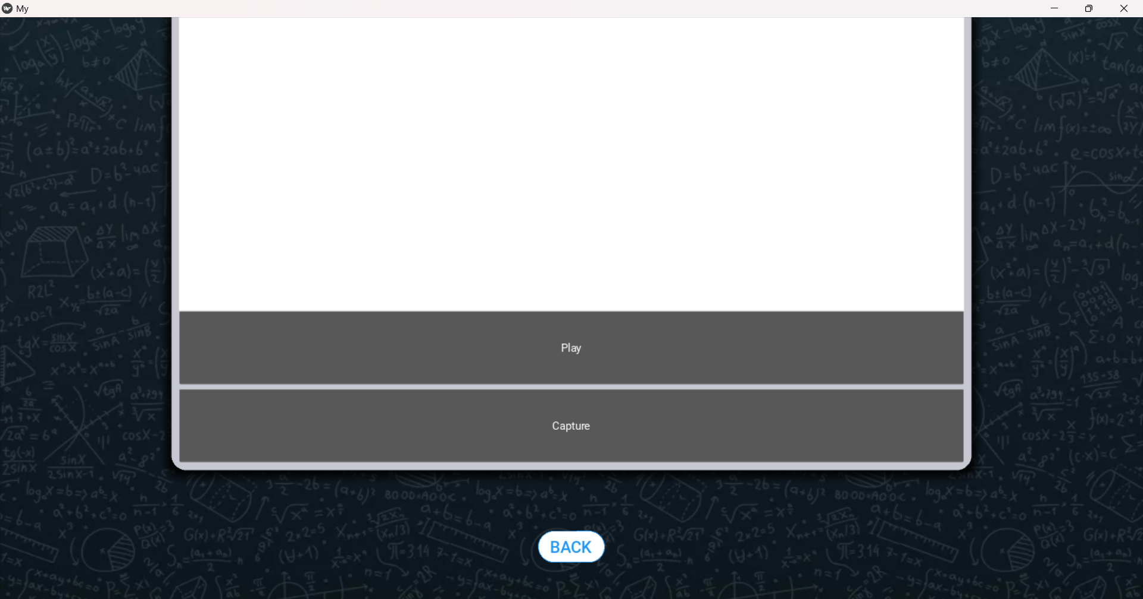
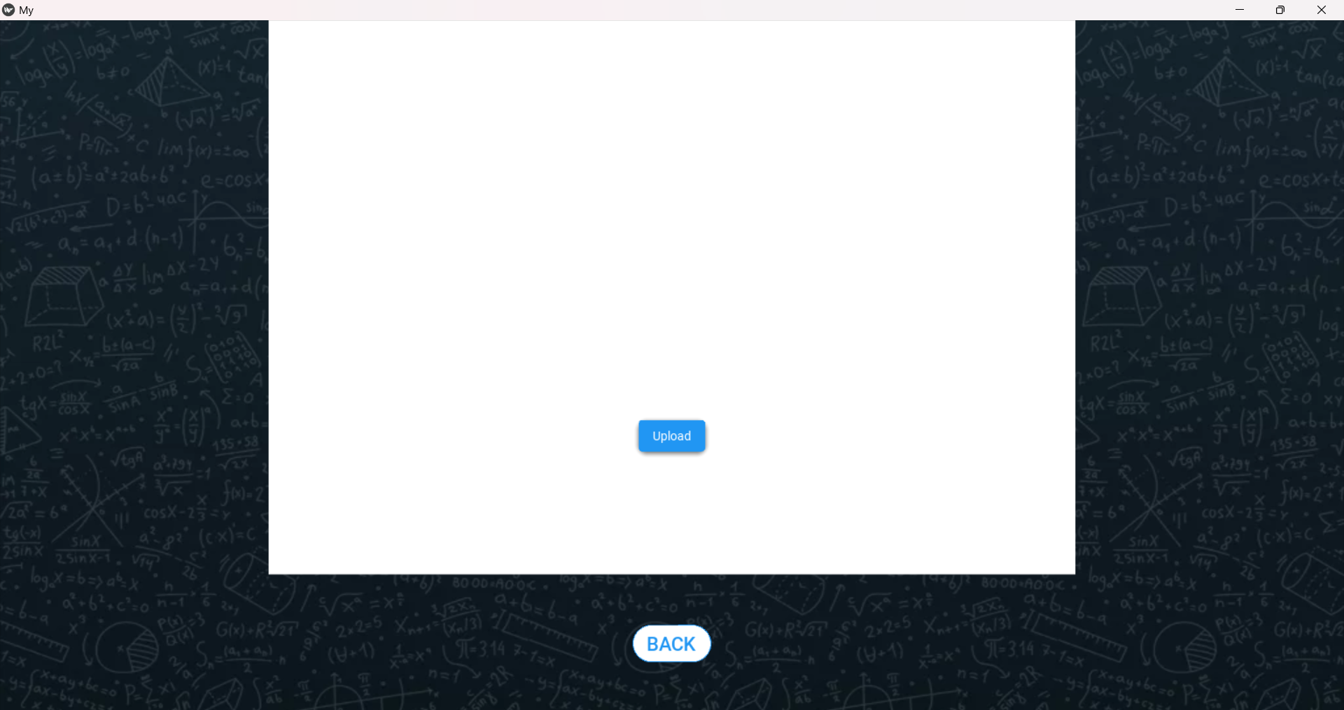
Application: Front-End

Slide 10
Objective
To make sure that images or video that are captured follow the General Data Protection Regulations.
Link GDPR and AI
Use Computer Vision to detect and blur parts of the images that reveal personal identity.
Develop ML models with a low false negative approach for removing the features

Slide 11
Literature Review
GDPR
A law framed by the European Union (EU) to protect the fundamental rights and freedoms, particularly the right to protection of personal data of an individual.
Personal Data[1] includes:
Facial Biometric Information
Location Data
Vehicle Registration Plates
Important Legal Documents
Online Identifier

Slide 12
Literature Review
German Law
As per the German Law, the identity of any individual should not be revealed under any circumstances unless consented or for legal reason [3].
Capturing of any photo or video that intrudes into a person’s privacy is prohibited by law in germany.
We need to make sure that the person can't be recognised in accordance with GDPR. Others include
,Tattoos
Clothes
Jewelry
Any Photo or Video which shows the helplessness of a person should not be shared.

Slide 13
Scope and Requirement
Build upto 3 Image Detection ML Models
Detect and blur Objects according to GDPR such as Human Face, Vehicle Registration number and Legal Documents including Passport, Driver’s License etc.
Build the AI model using CNN/OpenCV & TensorFlow

Slide 14
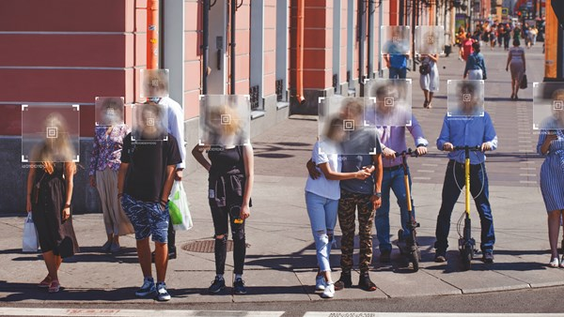
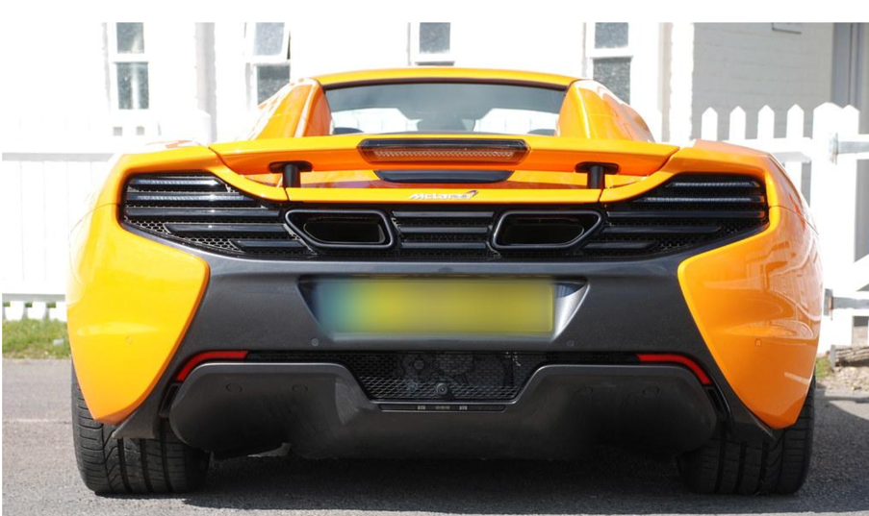
Scope and Requirement

Slide 15
Performance Tuning
In order to boost model performance
Adding for more images of low performing classes to your training set
Training for Longer
Changing Architecture

Slide 16
Timeline
11 Oct-02 Nov
16 Nov- 02 Dec
09 Dec- 18 Dec
Research
Data
Collection
Building
ML Code
Implementation
of Dataset in Code
Training,
& Testing
Results &
Report Submission
03 Nov- 15 Nov
03 Dec- 09 Dec
19 Dec - 21 Dec

Slide 17
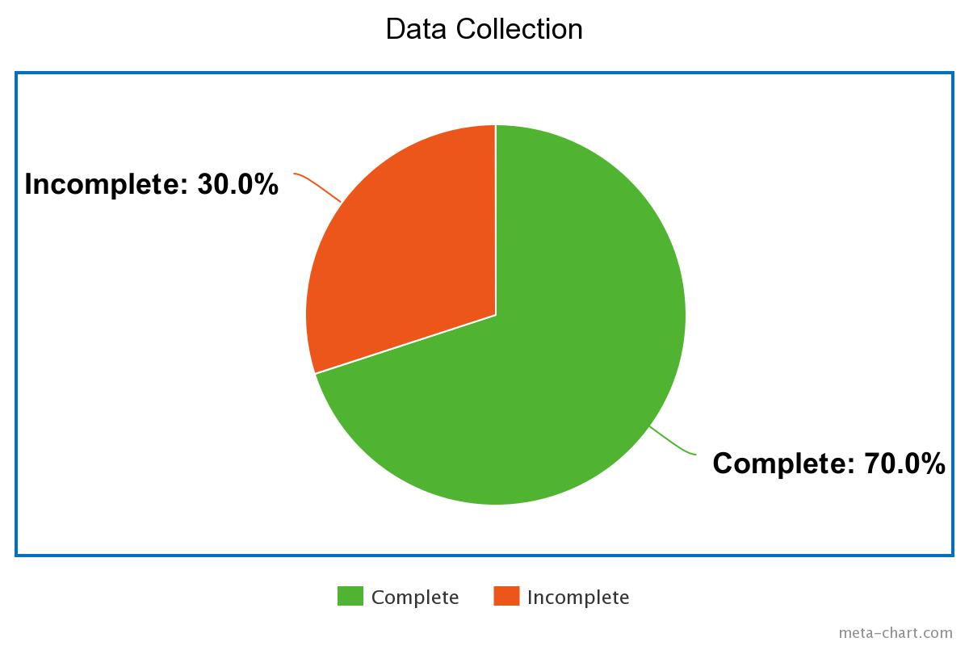
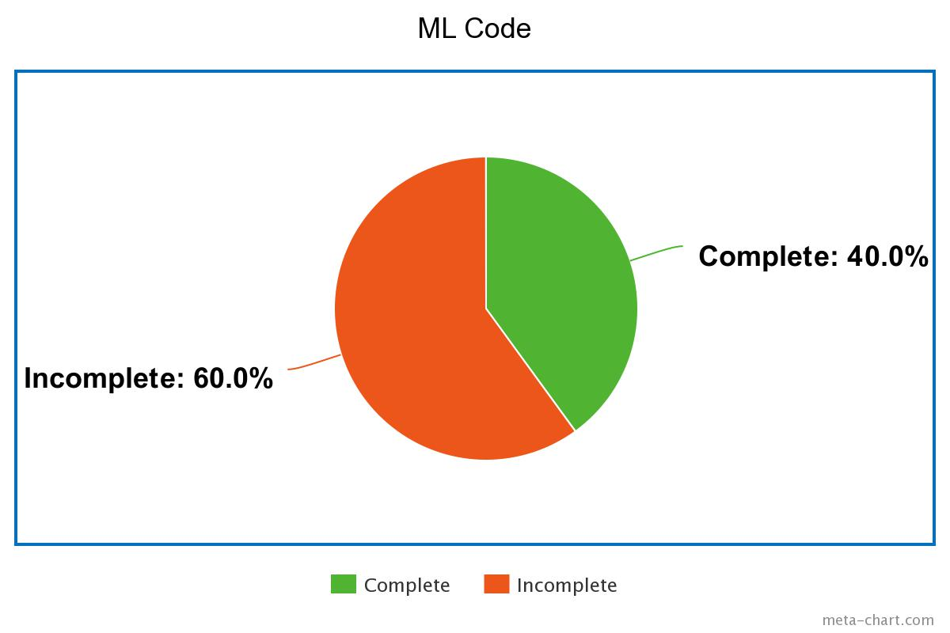
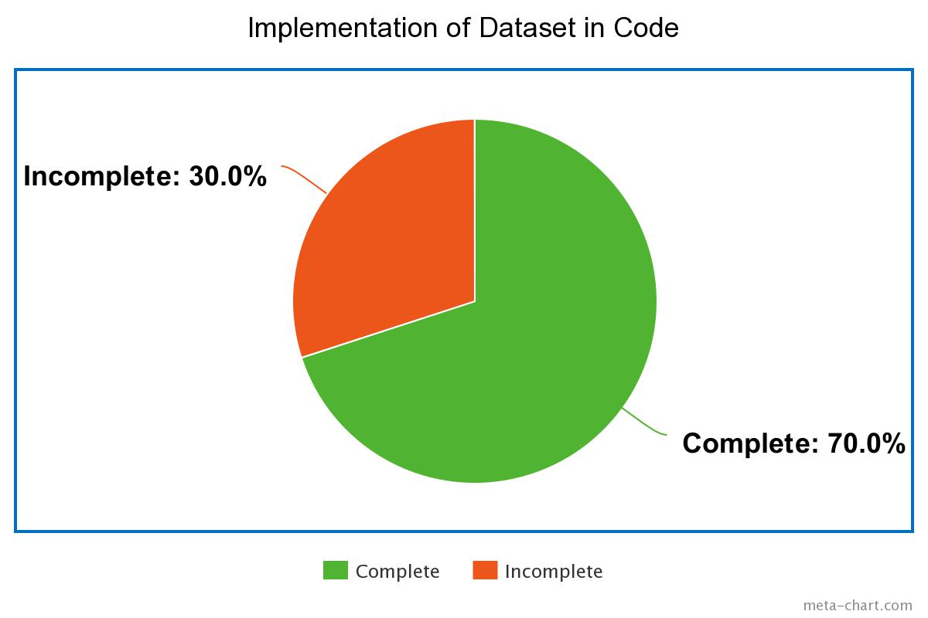

Progress Pie Chart

Slide 18
Progress Pie Chart

Slide 19
Reference
https://github.com/tensorflow/models/blob/master/research/object_detection/g3doc/tf2_detection_zoo.md
https://www.europarl.europa.eu/RegData/etudes/STUD/2020/641530/EPRS_STU(2020)641530_EN.pdf
https://allaboutberlin.com/guides/photography-laws-germany#how-do-i-get-permission

Slide 20
THANK YOU

